Slide 1
Quantifying Dividends of Climate Adaptation Interventions – the Case of GARID Project
Prof. M M Tuuli^{1*}, A/Prof E Adaku², A/Prof E Bugri-Anarfo² and Dr K O Sarfoh³
¹Loughborough University, UK
²Ghana Institute of Management and Public Administration (GIMPA), Ghana
³Ministry of Works and Housing, Ghana
*m.m.tuuli@lboro.ac.uk

Slide 2
Presentation Outline
01
04
Costs of GARID Interventions
Introduction to TDR
02
05
Dividends of GARID Interventions
GARID Project
03
Methodology
06
Conclusions

Slide 3
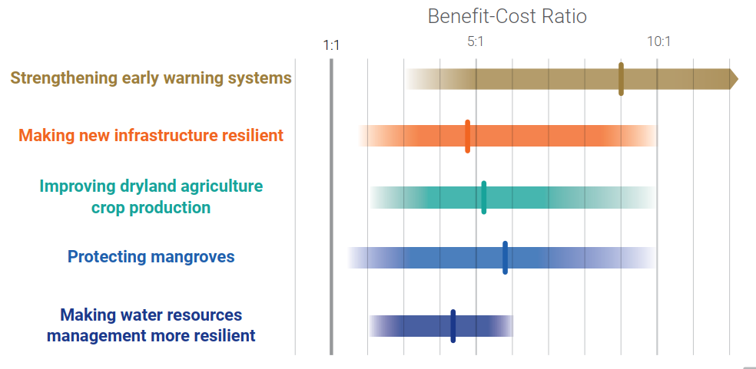
Benefits and Costs of Investments in Climate Adaptation
“The costs of adapting are less than the cost of doing business as usual. And the benefits many times larger.” - Ban Ki-moon, 8th Secretary General of the UN
Source: Global Commission on Adaptation (2019), Adapt Now.
3

Slide 4
Benefits and Costs of Investments in Climate Adaptation
If resilience investments have such large returns, why don’t people do more of them?
Is it the nature of the investments themselves?
They don’t generate cash flow.
They are long-term and therefore highly uncertain.
They are relatively small with high transaction costs.
They are complex (and there is scarce expertise).
They are untested.
Or the nature of the enabling environment?
Weak institutions
Weak incentives
Poor information
Lack of financing
[Generates policy recommendations]

Slide 5
The Triple Dividend of Resilience (TDR) Explained
The TDR approach is built on CBA but one that is broader than traditional CBAs, quantifying a wider range of benefits and grouping them along three dividends:
  avoided losses (Dividend I)
  induced economic and development benefits (Dividend II)
  additional environmental and social benefits (Dividend III)
Potential losses from climate impacts are more commonly quantified while second and, especially, third dividend benefits are not.

Slide 6
TDR Explained
The second and third dividend benefits accrue even when the anticipated disaster does NOT occur and are often larger than the “avoided losses” (the first dividend) that accrue when disaster does strike.
The total benefits of adaptation investments are often:
  larger than assumed,
  don’t always rely on the probabilities of disaster risk,
  and include significant private benefits.

Slide 7
TDR Analysis
Conducted by grouping benefits according to the 3 dividends and calculating NPVs and BCRs.
If new data can’t be modelled/ gathered (preferable), it may be possible to turn to evidence from other reports/ similar projects to draw assumptions for the case at hand, although this will be limited (e.g. economic analysis).
Costs and benefits need to be discounted over the period under analysis (e.g. 10-20 years).
Low discount rates are widely accepted to be more appropriate (e.g. 2%-3% or even lower).
Getting discount rates right is important for selecting the right projects during times of scarce public resources.

Slide 8
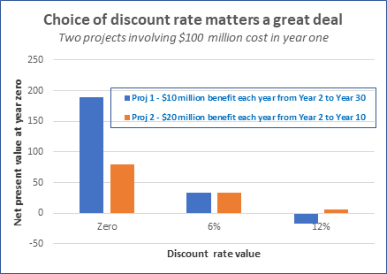
TDR Analysis
Source: Bramby and Cloutier (2022), World Bank Blogs.
Notes:
Comparing two similar projects (similar NPVs) using different discount rates reveals projects with benefits materialising over a longer period of time (typical climate adaptation projects) come out poorly when a higher discount rate is used.
Low discount rates can limit the risk of moral hazard.

Slide 9


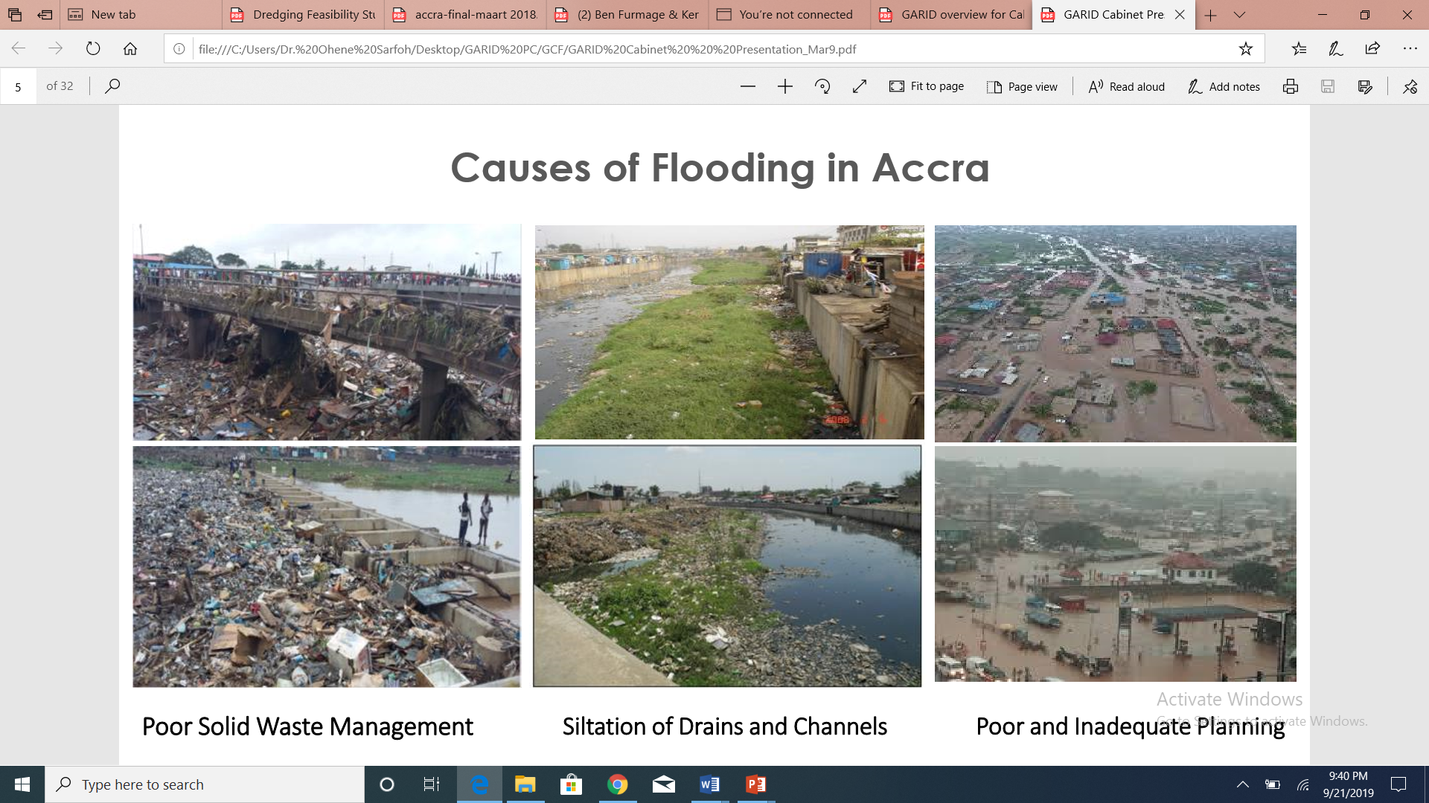
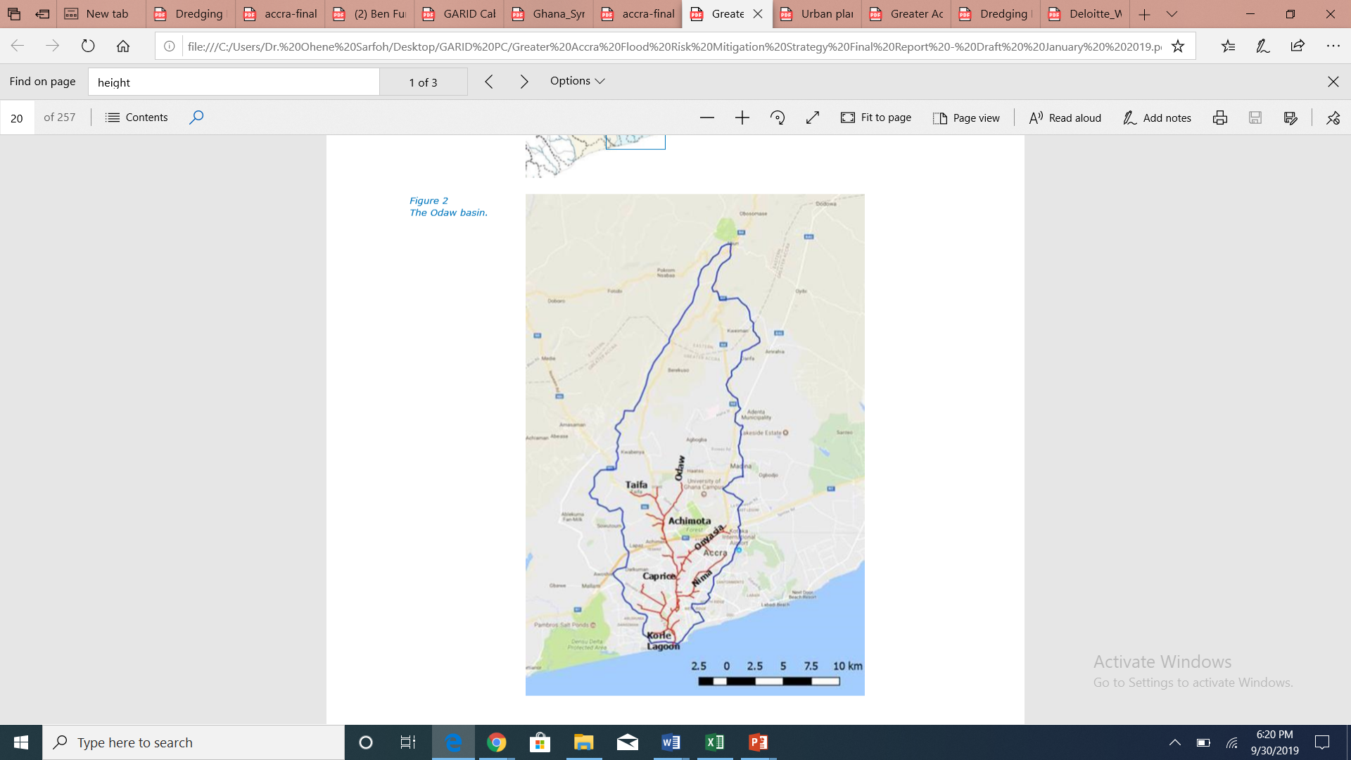





GOVERNMENT OF GHANA
Greater Accra Resilient and Integrated Development (GARID) Project
MINISTRY OF WORKS AND HOUSING
MINISTRY OF SANITATION AND WATER RESOURCES

Slide 10
Project Development Objectives
The objective of the project is
to improve flood risk management and solid waste management in the Odaw River Basin of the Greater Accra Region and
improve access to basic infrastructure and services in the targeted communities within the Basin.

Slide 11
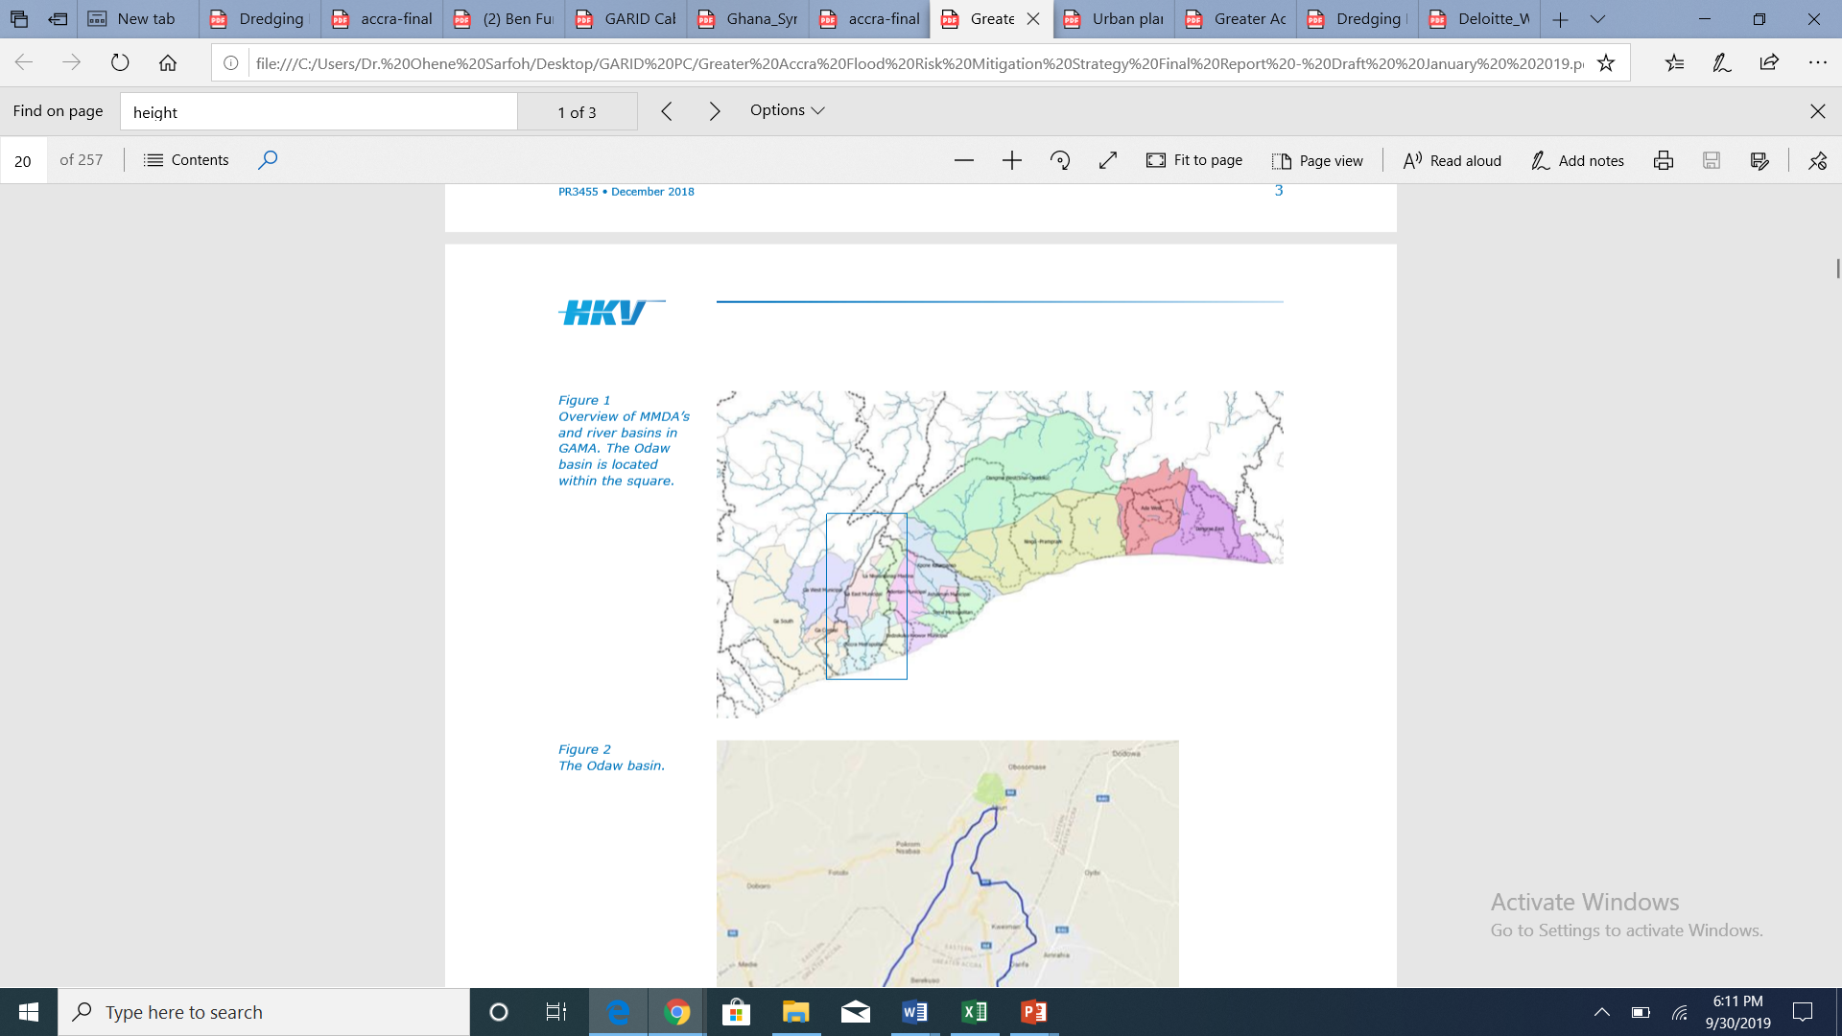
Accra & The Odaw River / Drainage Basin
July 4th 1968
June 29th 1971
May 5th 1986
May 5th 2010
June 22nd 2010
Feb 24th 2011
Nov 1st 2011
May 31st 2013
June 6th2014
July 4th 2014
June 3rd 2015
June 9th 2016
Oct 6th 2017
June 18th 2018
July 14th 1991
July 5th 1995
June 13th 1997
Sept 1999
June 27- 28 ’01
Greater Accra Metropolitan Area ≈ 4.5million → 8 million (2035)
9 River/Drainage basins
Odaw Drainage Basin ≈ 273 km² (Area) & 30km (length) approx.

Slide 12
CHRONOLOGY
June 3rd Floods
  131mm of rain in 6 hours (compared to 2007 when 252mm over 2 days)
  High tide (reverse flow from the Sea to circle/caprice)
  Shut flaps of interceptor wier
  Fire explosion
Damage assessment:
152 lives lost
53,000 directly affected
77,000 buildings fully or partially destroyed
USD 55 million damage
USD 115 million cost of repairs
STRUCTURAL CAUSES
Sediment build-up around wier
Solid waste dumping in drain

Slide 13
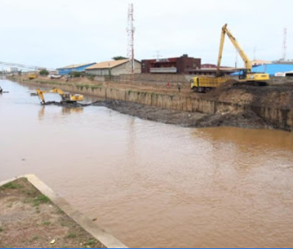
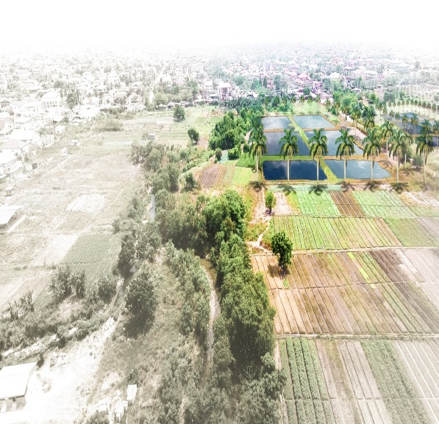
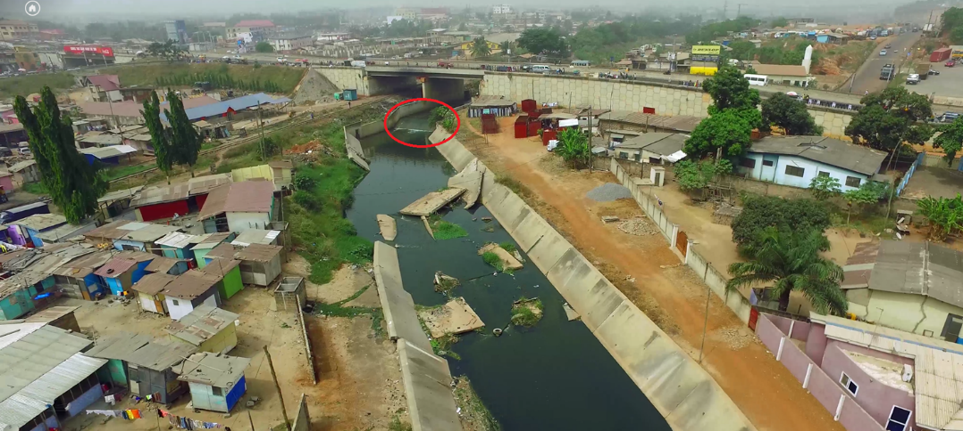
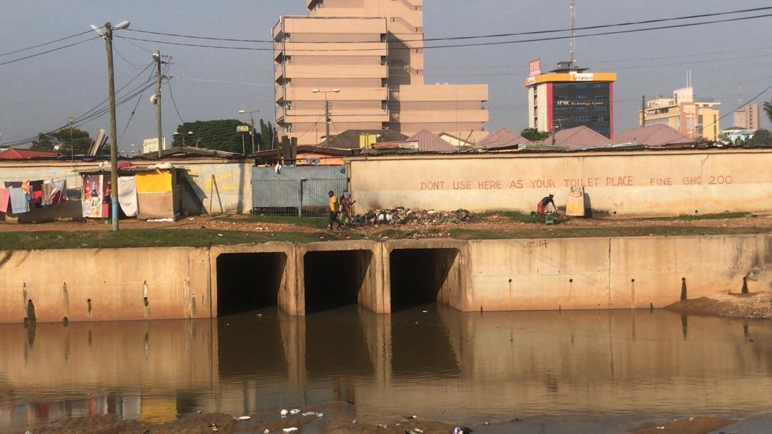
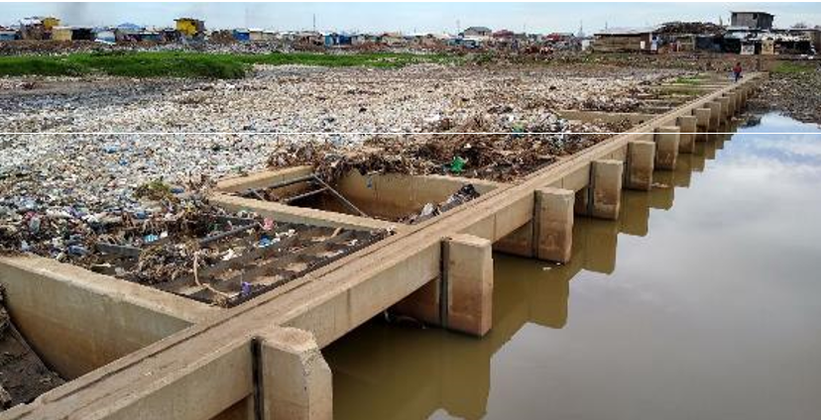
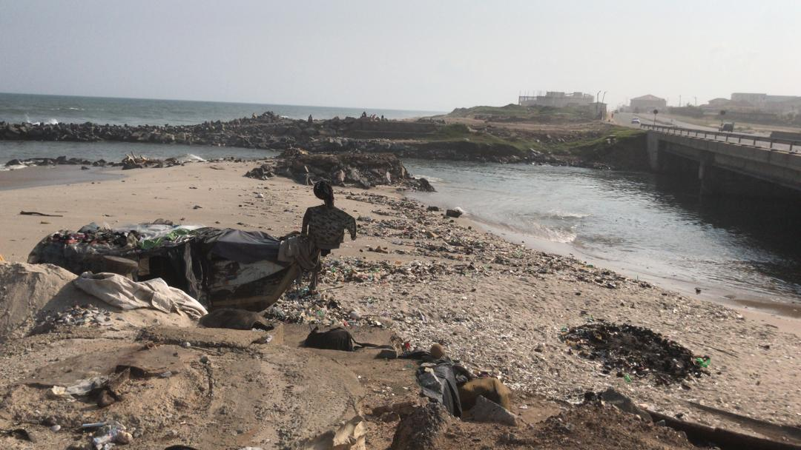
Climate Resilient Drainage and Flood Mitigation
Routine Dredging of Odaw
Detention Pond / Sand traps
Repair of Drains
Replacement of Bridges
Interceptor Weir
Odaw Outlet into the Sea

Slide 14
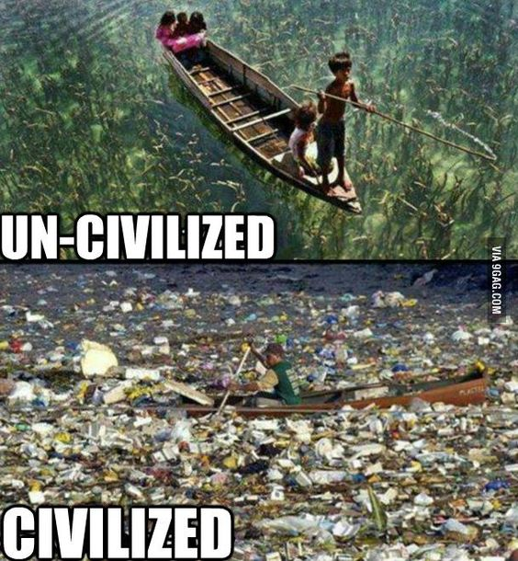
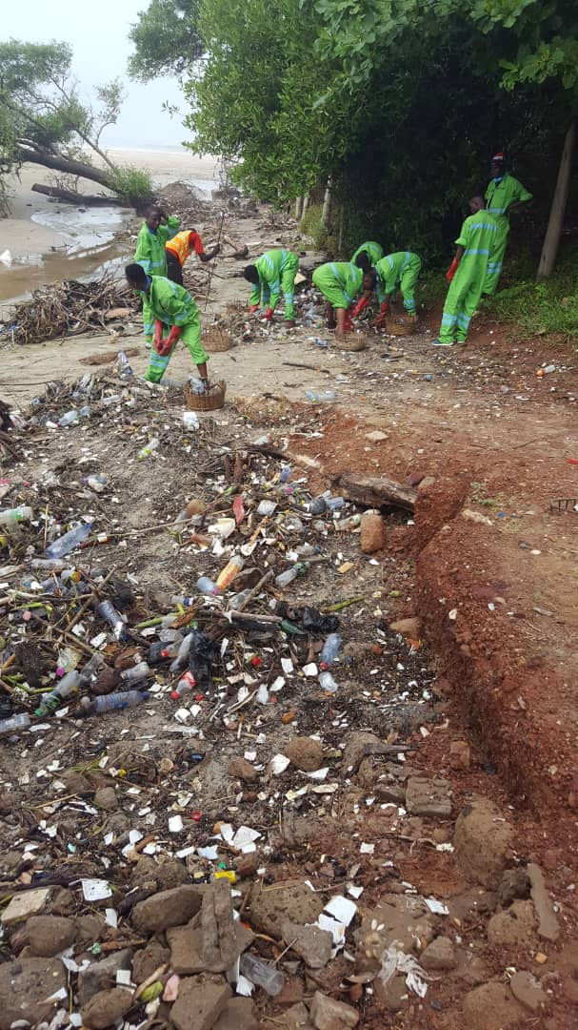

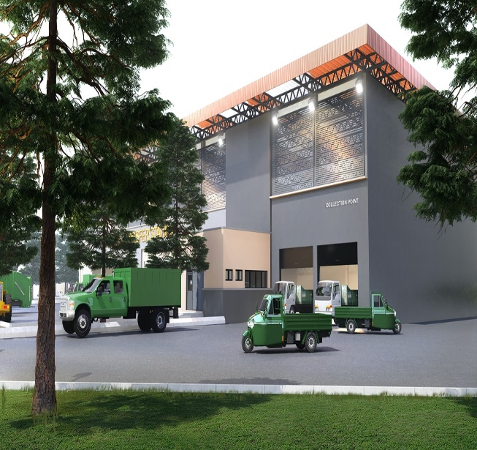
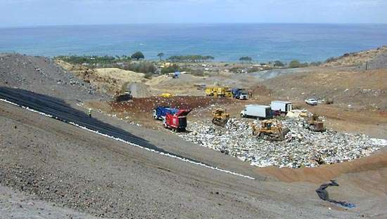
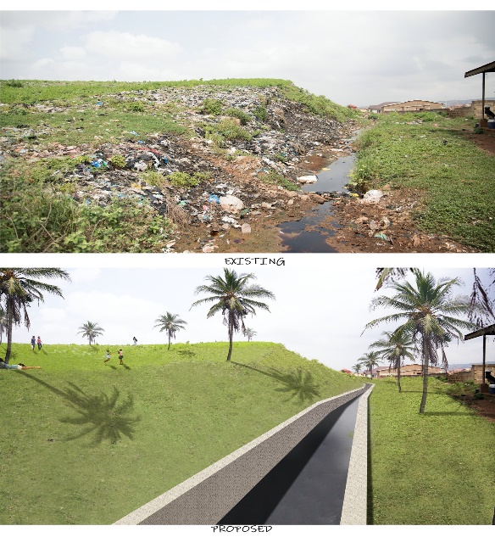
  Solid Waste Management
Litter management
Major Outreach Programme
Community-based interventions
Waste Tranfer Station
Landfill Site at Ayidan Saklah
Capping

Slide 15
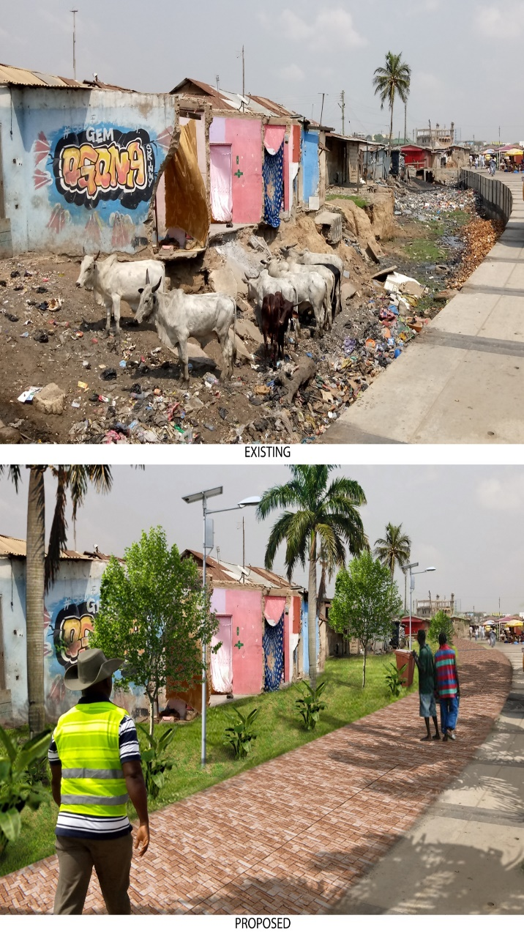
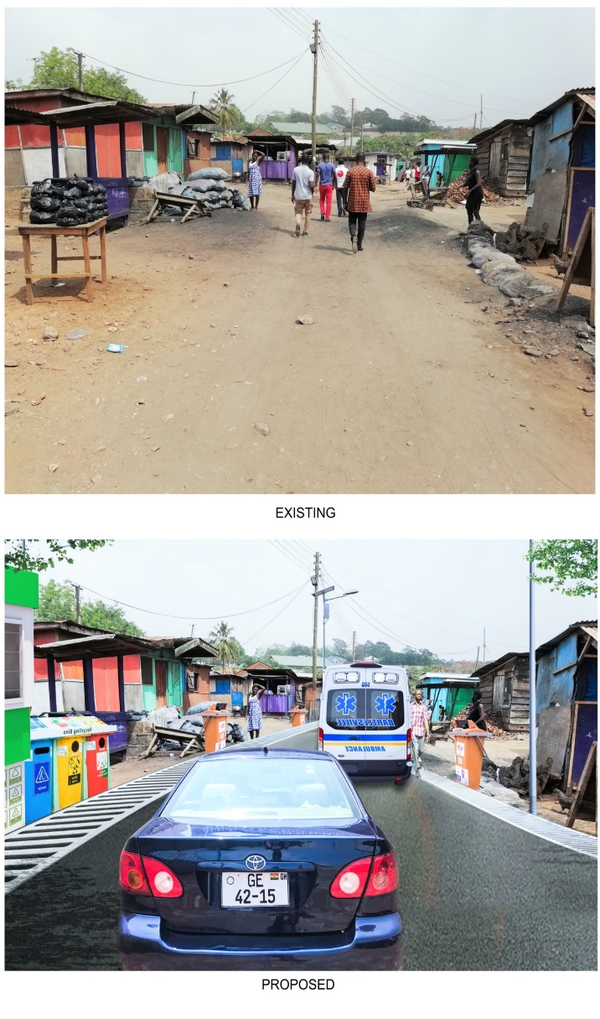
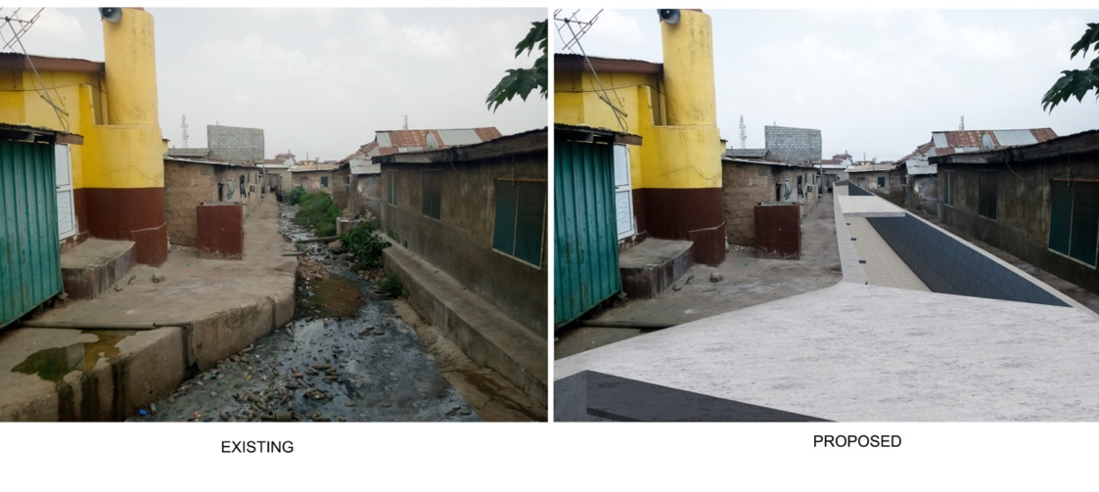
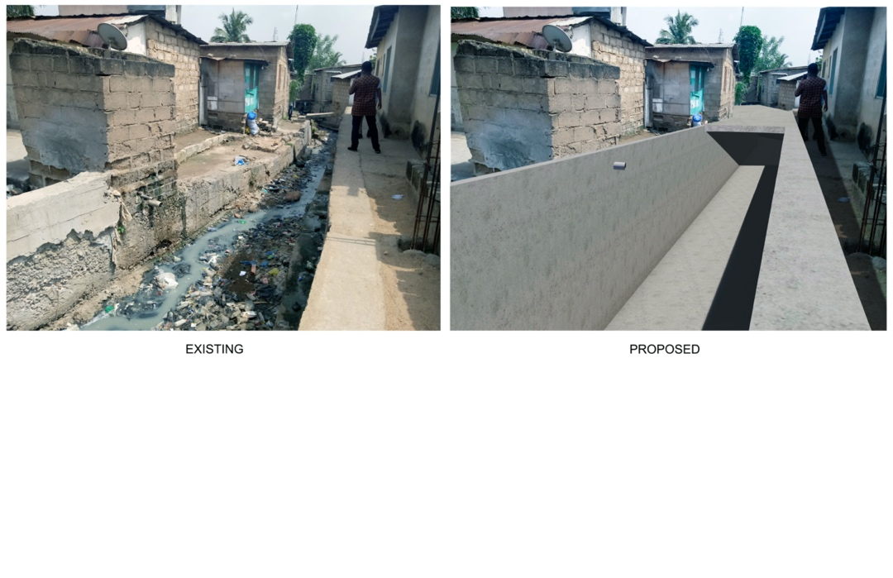
Upgrading of Targeted Flood Prone Low-income Communities
Proposed Upgrading Work in Nima
Proposed Upgrading Work in Alogboshie
Proposed Upgrading Work in Akweteman

Slide 16
Methodology
Case study approach - GARID Project
Methods
  Secondary analysis (desk study) of reports, literature, etc
  Interviews and Validation discussions with some project officials
  Quantify & Group costs and benefits, applying Tripple Dividends Model

Slide 17
Methodology
Discount rates adopted
  3%,
  5%, and
  8%.
Justifications
  Lower discount rates for long-run projects ensures that the long-term benefits are adequately valued, promoting sustainable and equitable decision-making.
  Future cash flows are expected to be larger due to economic growth - lower discount rate can capture this expected growth more accurately
  For public sector projects, the opportunity cost of capital is often lower than for private sector projects.
  higher discount rate would diminish the present value of future benefits, potentially undervaluing the project's long-term impact.

Slide 18
Methodology
Justifications
  long-term projects are subject to more uncertainty, including economic, political, and environmental changes.
  lower discount rate can partly mitigate the effect of uncertainty by not overly penalizing the project's future cash flows, thus providing a more balanced view of the project's potential value.
  Lower discount rates help ensure that the interests of future generations are considered.
  Bramby and Cloutier (2022) even make a case for adopting zero discount rates as appropriate for discounting costs and benefits of most investment projects - and especially climate-sensitive ones.

Slide 19
Quantifying Costs of Interventions
Costs covers
  Construction
  Operations and maintenance (O&M)
  Contingencies
  Design studies and supervision
  Resettlement costs.

Slide 20
Costs of GARID Interventions

Slide 21
Avoided Losses Arising from GARID – Dividend I
Analysis of simulated/calculated damage without, and with the project interventions
Interventions are estimated to mitigate about 48.5% of the possible flood damage in the Odaw River Basin by 2050
Economically, about 40 percent of economic assets are currently at risk of flooding in the Odaw Basin
Combination of expected avoided damages and estimated economic assets at risk between 2018 and 2050 are discounted in 3 scenarios corresponding to 8%, 5% and 3%
Notes:
(World Bank, 2020).
(Oteng-Ababio, Ablo and Wong, 2020).
(Wong and Dubosse, 2019, Lomborg, Annim and Nordjo, 2021).

Slide 22
Avoided Losses Arising from GARID – Dividend I
Notes:
¹Estmated from GARID Project Implementation Status & Results Report (World Bank, 2023)
2Estimated from reports of simulated damage averted, estimates of annual loss from floods, flood damage estimates and Cost Benefit Analysis of investment options for the year range of 2018 to 2050 (World Bank, 2020; Oteng-Ababio, Ablo and Wong, 2020)

Slide 23
Induced Economic or Development Benefits Arising from GARID – Dividend II
Indirect economic benefits gained through less transport and business interruption.
Avoided reduced economic activity, loss of trading time and market demand for products, and reduced disruption to businesses as well as reduced disruptions to commuters.
Dividend II is grossly underestimated due to data limitations – missing include investments stimulated by climate change interventions, lowering of insurance premiums, increased in tourism and employment opportunities, etc.
Notes:
(Oteng-Ababio, Ablo and Wong’s (2020)
(World Bank 2020)
(Erman et al., 2018).

Slide 24
Induced Economic or Development Benefits Arising from GARID – Dividend II
Notes:
1Estmated from GARID Project Implementation Status & Results Report (World Bank, 2023)
2Estimated based on less transport and business interruption (Oteng-Ababio, Ablo and Wong, 2020)

Slide 25
Social and Environmental Benefits Arising from GARID - Dividend III
Not much research has been conducted on the environmental dividends of the GARID program compared to the social and economic dividends.
Benefits from enhancing biodiversity conservation
Reduction of disease burden (such as diarrheal disease and avoided deaths)
Cleaner environment within the community, with corresponding improved health benefits
Welfare benefits associated with improved access to services and infrastructure
Notes:
(Maund and Anyidoho, 2019)
(Oteng-Ababio, Ablo and Wong, 2020

Slide 26
Social and Environmental Benefits Arising from GARID - Dividend III
Net emissions reduction of 24,940,903 tCO2e over the economic lifetime of the project.
World Bank’s State and Trends of Carbon Pricing Dashboard indicates a fluctuating carbon pricing which currently ranges of US$0.46 to US$167 per ton, with average of US$83.73 per ton.
The only carbon pricing available in Africa is in South Africa according to the World Bank’s State and Trends of Carbon Pricing Dashboard and is currently priced at US$10.09 per ton.
Four carbon pricing scenarios (Low, Average, High, South Africa)
Notes:
(World Bank, 2019)

Slide 27
Social and Environmental Benefits Arising from GARID - Dividend III
Notes:
1Estmated from GARID Project Implementation Status & Results Report (World Bank, 2023)
2Estimated based on reduction in disease burden and cleaner environment, welfare improvements and net carbon emission reductions (Oteng-Ababio, Ablo and Wong, 2020; World Bank, 2019). Estimated also based on reduction in disease burden and cleaner environment (Oteng-Ababio, Ablo and Wong, 2020). Estimated, further based on net emissions reduction over the economic lifetime of the project (World Bank, 2019).

Slide 28
Social and Environmental Benefits Arising from GARID - Dividend III
Notes:
1Estmated from GARID Project Implementation Status & Results Report (World Bank, 2023)
2Estimated based on reduction in disease burden and cleaner environment, welfare improvements and net carbon emission reductions (Oteng-Ababio, Ablo and Wong, 2020; World Bank, 2019). Estimated also based on reduction in disease burden and cleaner environment (Oteng-Ababio, Ablo and Wong, 2020). Estimated, further based on net emissions reduction over the economic lifetime of the project (World Bank, 2019).

Slide 29
Social and Environmental Benefits Arising from GARID - Dividend III
Notes:
1Estmated from GARID Project Implementation Status & Results Report (World Bank, 2023)
2Estimated based on reduction in disease burden and cleaner environment, welfare improvements and net carbon emission reductions (Oteng-Ababio, Ablo and Wong, 2020; World Bank, 2019). Estimated also based on reduction in disease burden and cleaner environment (Oteng-Ababio, Ablo and Wong, 2020). Estimated, further based on net emissions reduction over the economic lifetime of the project (World Bank, 2019).

Slide 30
Social and Environmental Benefits Arising from GARID - Dividend III
Notes:
1Estmated from GARID Project Implementation Status & Results Report (World Bank, 2023)
2Estimated based on reduction in disease burden and cleaner environment, welfare improvements and net carbon emission reductions (Oteng-Ababio, Ablo and Wong, 2020; World Bank, 2019). Estimated also based on reduction in disease burden and cleaner environment (Oteng-Ababio, Ablo and Wong, 2020). Estimated, further based on net emissions reduction over the economic lifetime of the project (World Bank, 2019).

Slide 31
Costs and Dividends of GARID Interventions
Notes:
¹Estmated from GARID Project Implementation Status & Results Report (World Bank, 2023)
²Estimated from reports of simulated damage averted, estimates of annual loss from floods, flood damage estimates and Traditional Cost Benefit Analysis of investment options for the year range of 2018 to 2050 (World Bank, 2020; Oteng-Ababio, Ablo and Wong, 2020)
³Estimated based on reduction in disease burden and cleaner environment, welfare improvements and net carbon emission reductions (Oteng-Ababio, Ablo and Wong, 2020; World Bank, 2019). Estimated also based on reduction in disease burden and cleaner environment (Oteng-Ababio, Ablo and Wong, 2020). Estimated, further based on net emissions reduction over the economic lifetime of the project (World Bank, 2019).

Slide 32
Costs and Dividends of GARID Interventions
Notes:
¹Estmated from GARID Project Implementation Status & Results Report (World Bank, 2023)
²Estimated from reports of simulated damage averted, estimates of annual loss from floods, flood damage estimates and Traditional Cost Benefit Analysis of investment options for the year range of 2018 to 2050 (World Bank, 2020; Oteng-Ababio, Ablo and Wong, 2020)
³Estimated based on reduction in disease burden and cleaner environment, welfare improvements and net carbon emission reductions (Oteng-Ababio, Ablo and Wong, 2020; World Bank, 2019). Estimated also based on reduction in disease burden and cleaner environment (Oteng-Ababio, Ablo and Wong, 2020). Estimated, further based on net emissions reduction over the economic lifetime of the project (World Bank, 2019).

Slide 33
Conclusions
The cost of the GARID interventions is US$276 million
The total benefits of the GARID interventions ranges between US$451.97 to US$6,269.50 million
The NPV of the GARID interventions ranges between US$175.97 and US$5,993.5 million
The BCR of the GARID interventions ranges between 1.64 and 22.72
Data availability, discount rates and carbon pricing variability make the difference in total benefits, NPV and BCR estimates
Irrespective of the assumptions made the GARID project interventions are viable based on the total investments and the total benefits that will accrue.
Dividend II and III enhances the BCR between 22% and 1,596%!
TDR is a credible evidence-based decision making and investment planning approach.

Slide 34
Thank you
Professor martin morgan tuuli
Professor of operations & project management
  m.m.tuuli@lboro.ac.uk/+233558081555

